Slide 1
Welcome to Hy-Tech Camp!!
Building a Webpage: HTML & CSS
Notes:
Introduce the instructors: Name, Title (Dev/Qa/Etc), College Major (if applicable), How you ended up at Hyland.
Ask students to introduce themselves: Name, School, if they have ever used HTML or CSS
Make sure drinks have lids on them, if you need to use the restroom just ask one of the instructors in the back

Slide 2
AGENDA
Phase 1: What is the internet and why does it work?
Phase 2: HTML Tags
Phase 3: CSS and styling your page
Phase 4: How to keep learning

Slide 3
What is the internet?
Notes:
Ask the students what they think the internet is and how they think it works.
-> There are no wrong answers here, the students are here to learn the answer to these questions
Use the candy as incentives for students who answer questions and participate

Slide 4

Notes:
Now we’re going to watch a short video where Vint Cerf, one of the people who invented the internet, goes over a brief description and history of the internet.

Slide 5
How does it work?

Slide 6



How does it work?
User
Browser
Server
Notes:
The user opens a browser and enters the name of a website.
The browser requests the website from a server where the website lives.
The server sends HTML back to the browser, which then displays it to the user.
Don’t need to go too in-depth with this stuff, they don’t need to learn it now.

Slide 7
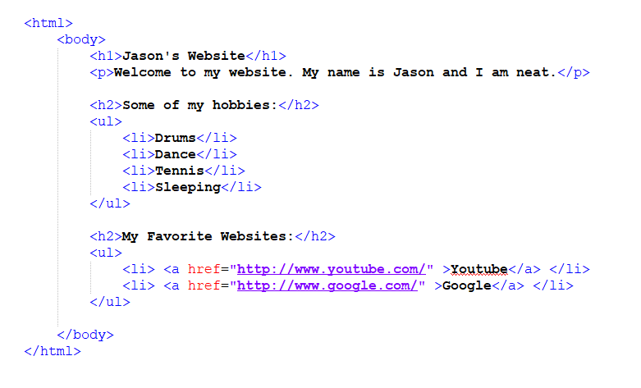
How does a browser use HTML?
Notes:
HTML is behind every user interface on the web. This is what HTML looks like when it is sent to the browser. The browser reads the text, interprets it, and shows it to the user.

Slide 8
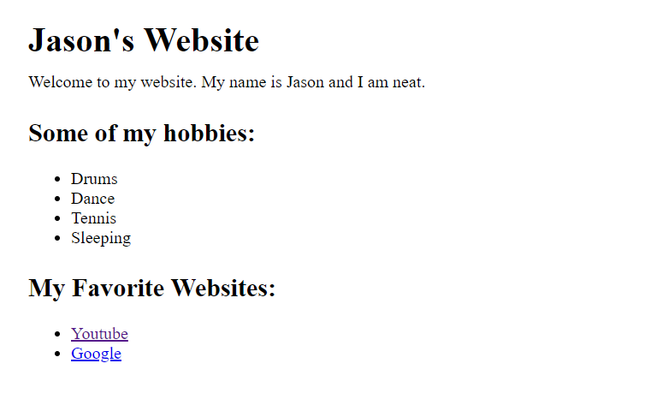
How does a browser use HTML?
Notes:
The browser interprets that HTML and turns it into what we see as a website, like this.

Slide 9
HTML Tags
Notes:
In this section, we will discuss what are HTML Tags and how do we use them?
After we go over the basics, you’ll get a chance to write some HTML yourself
Ask if anyone knows what HTML stands for
Use the candy as incentives for students who answer questions and participate
Answer: Hyper Text Markup Language

Slide 10
What is an HTML Tag?
An HTML Tag is the text version of the graphical things you see on a Webpage
HTML Tags tell the page where to put buttons and input fields.
HTML Tags also tell the page how to align things.
Without HTML tags the internet as you know it wouldn’t exist.

Slide 11
Examples…
<html>
Tells the browser this is an HTML Page
<body>
Defines the visual body of the webpage
<h1>
The header
<img>
Displays an image
<p>
Displays text
Notes:
Examples of basic tags used today…

Slide 12
HTML Challenges!
Notes:
Let’s write some markup!
Reminder: Give the students one 10 minute break at some point (no later than 7PM)

Slide 13
Let’s get started
Log into your computer
.\user
onbase
Open up Google Chrome and head to www.hylandtechclub.com
Open Hy-Tech Camps
Open Building a Webpage
Download “HTML & CSS.zip”
Notes:
.\User -> Be sure you use the correct slash, it is above the Enter key on the keyboard
onbase -> this is the password

Slide 14
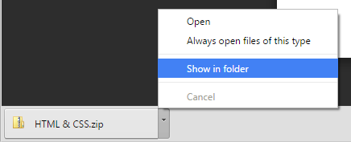
Let’s get started
Click “Show in folder” where the .zip file downloaded

Slide 15
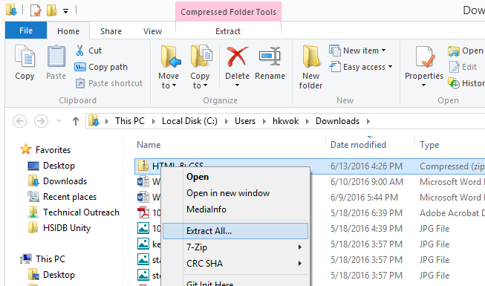
Let’s get started
Right click & press “Extract All…”

Slide 16
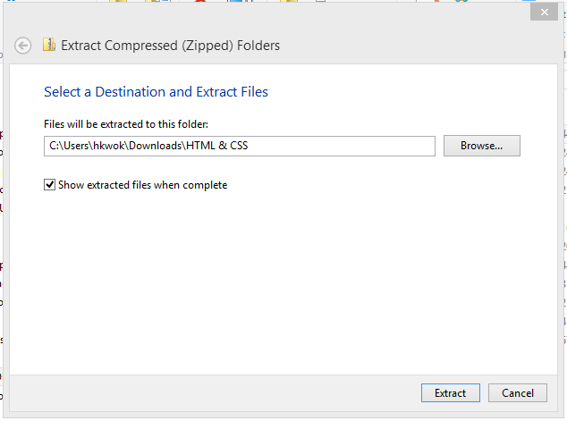
Let’s get started
Click “Extract”

Slide 17
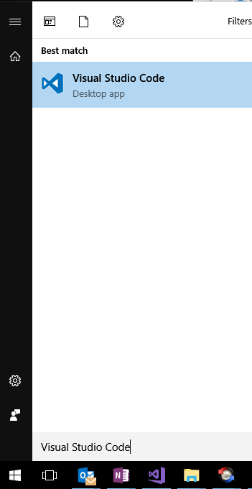
Let’s get started
Open Visual Studio Code

Slide 18
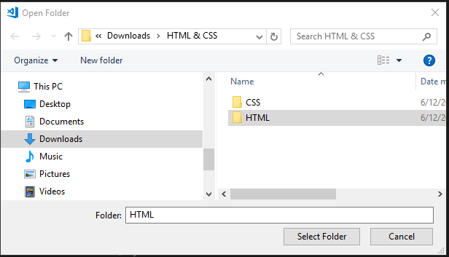
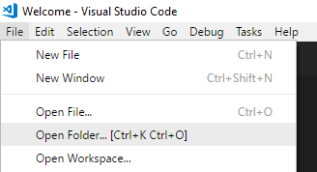
Let’s get started
Click File … Open Folder …
Find the location of the extracted folder
C:\Users\User\Downloads\HTML & CSS
Select the HTML Folder

Slide 19
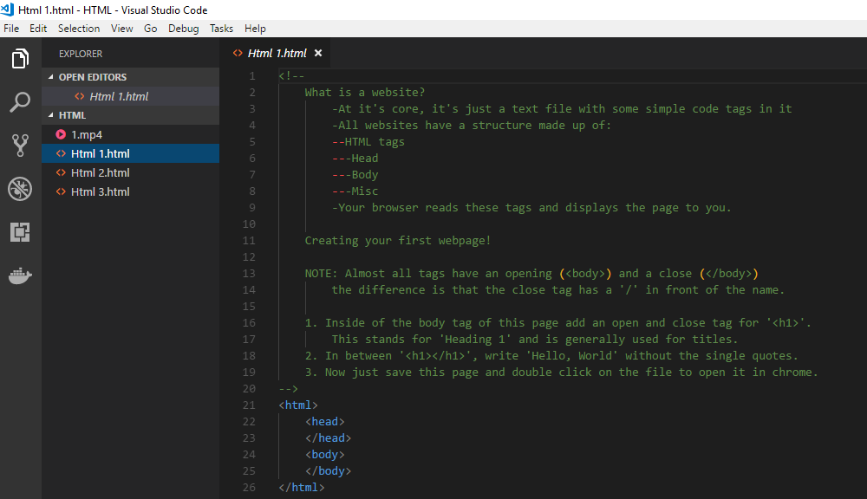
Let’s get started
Open and Work on Html1.html, Html2.html, and Html3.html files
Follow the GREEN commented directions

Slide 20
HTML Review
Review time!

Slide 21
CSS & Styling
Notes:
Ask if anyone knows what CSS stands for
Use the candy as incentives for students who answer questions and participate
Answer: Cascading Style Sheets
Reminder: Give the students one 10 minute break at some point (no later than 7PM)

Slide 22
What is CSS?
Tells the webpage how to look
Allows us to easily and quickly restyle an entire webpage or webpages
Easy to learn
Can exist in the HTML file or can have it’s own file
Notes:
While HTML might say where to put the button or where to put the text, CSS says what color it should be, or if the button should animate when the mouse goes over it

Slide 23
Example….
<head>
<style>
h1 { color: Red; }
</style>
</head>
Notes:
A simple example of styling the header tag

Slide 24
CSS Challenges!
Notes:
Lets write some CSS!
Reminder: Give the students one 10 minute break at some point (no later than 7PM)

Slide 25
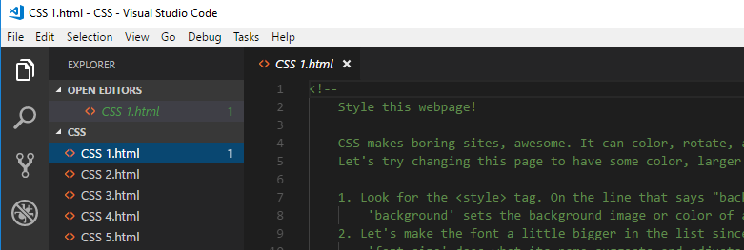
Have fun with CSS!
In VS Code, Open the CSS Folder, using File … Open Folder
Work on CSS 1 through CSS 6
Follow the commented directions
Notes:
Separate into 2 different folders (CSS & HTML)

Slide 26
CSS Review
What's a kahoot?

Slide 27
Keep Learning!
W3Schools.com
Great, comprehensive documentation of all things HTML, CSS, and JavaScript
Codecademy.com
Self-guided, free, online lessons for HTML, CSS, and more!
Notes:
Ask if anyone has any questions about Hyland, HTML, CSS, etc before they leave
Thank them for attending, point them to the email address on the board if they ever have any questions (techoutreach@hyland.com)

Slide 28
techoutreach@hyland.com

Slide 29
Really the only thing that makes sense is to strive for greater collective enlightenment.
- Elon Musk
Notes:
Classes need to be walked back up to the front desk afterwards
One instructor per room stays back to close up the training room (see checklist at the front of room)
At least two Hyland employees need to wait with the students getting picked up!

